Slide 1
Desk Expectation
Raise your hand to speak
• Eyes on speaker
• Nothing in hands
• Stay in seat

Slide 2
Elementary School Life in Japan

Slide 3
Do you know these symbols?
3

Slide 4
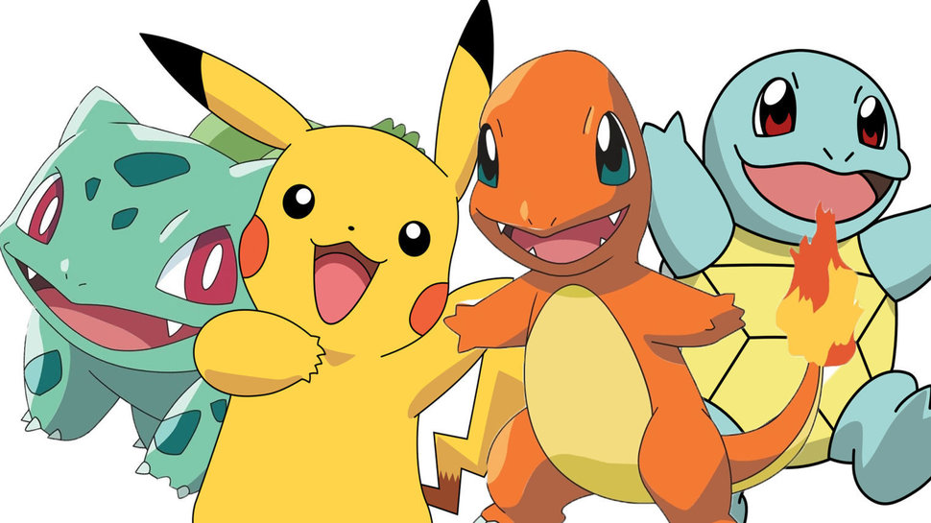
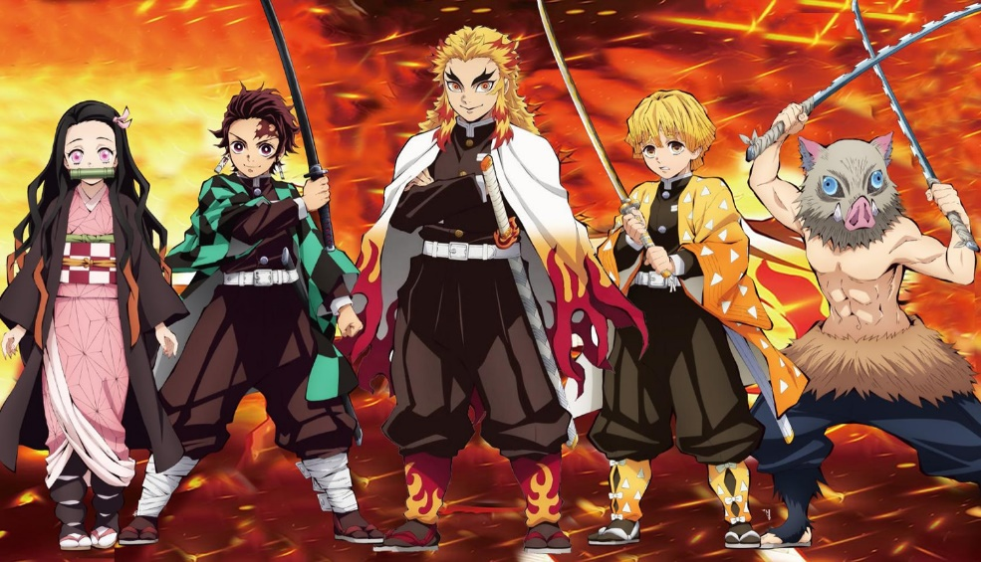
What else is from Japan?
4

Slide 5
Where is Japan?
日 本
シ ア ト ル

Slide 6
What Map is this?
Notes:
This is a place I think we can talk a little about diversity.
This map is a very visual opportunity for students to learn how people in other parts of the world see everyone else.
In this map, the US looks much smaller than on our maps.

Slide 7
Seattle Space Needle
Tokyo Skytree
?
How many hours to fly from Seattle to Japan?
一、二、三、四、五、六、七、八、九、十

Slide 8
Kazoku
かぞく
’Family’
otōsan
okāsan otōto

Slide 9
Genkan
げ ん か
ん
Randoseru
ラ ン ド セ
ル

Slide 10
©Japan-America Society of State of Washington
“Itte kimasu!”
“Itte rasshai!”

Slide 11
How do students get to school?

Slide 12
“Itte kimasu!”
©Japan-America Society of State of Washington
“Itte rasshai!”

Slide 13
GAKKō
School Buildings

Slide 14
What are all these shoes?!

Slide 15
Don’t forget to change into
“UWABAKI” (indoor school shoes)
They leave their street shoes
in cubbies at the entrance

Slide 16
Kiritsu
Rei Chakuseki
“Ohayō Gozaimasu”

Slide 17
In the Classroom

Slide 18
KOKUGO (Language Arts)
Japanese has 3 ways of writing
Hiragana (46 letters)
Katakana (46 letters)
Kanji (Chinese characters)
Kanji Memorization
1st grade (80)
2nd grade (160)
3rd grade (200)
4th grade (200)
5th grade (185)
6th grade (181)
Total 1006 Kanji by 6th grade Another 939 Kanji by 9th grade

Slide 19
Hiragana
Katakana
a
i ueo

Slide 20
Kanji
does
Hint:
What
like?
in
Something
nature…
it look

Slide 21
Let’s look at textbooks from Japan!
✐ What subject you have?
✐ Can you find hiragana, katakana or kanji?
✐ Do any textbooks open from the back?

Slide 22
Kyūshoku
Lunchtime
き ゅ う し ょ く
©Japan-America Society of State of Washington

Slide 24
Lunch crew passes out
and bowls
Please do not open chopsticks until everyone is “served”
Place bowl and chopsticks exactly like

Slide 25
Itadakimasu!

Slide 26
How to hold chopsticks
1.Tuck under thumb and hold tight. 2.Add second chopstick; hold it as you
hold a pencil.
3.Hold first chopstick tight. Move the second one up and down.

Slide 27
Gochisōsama

Slide 28
We will collect all bowls
You may keep chopsticks and erasers
Please place them into your desk now

Slide 29
Jan–ken-pon!

Slide 30
そ う
じ
School Cleaning

Slide 32
M C l e a n i n g o
r e
What’s this???
What’s this

Slide 33
Owari no kai
End of the day in homeroom
“Sayōnara”

Slide 34
Any Questions?

Slide 35
“ありがとうございました”
“さようなら”

