Slide 1
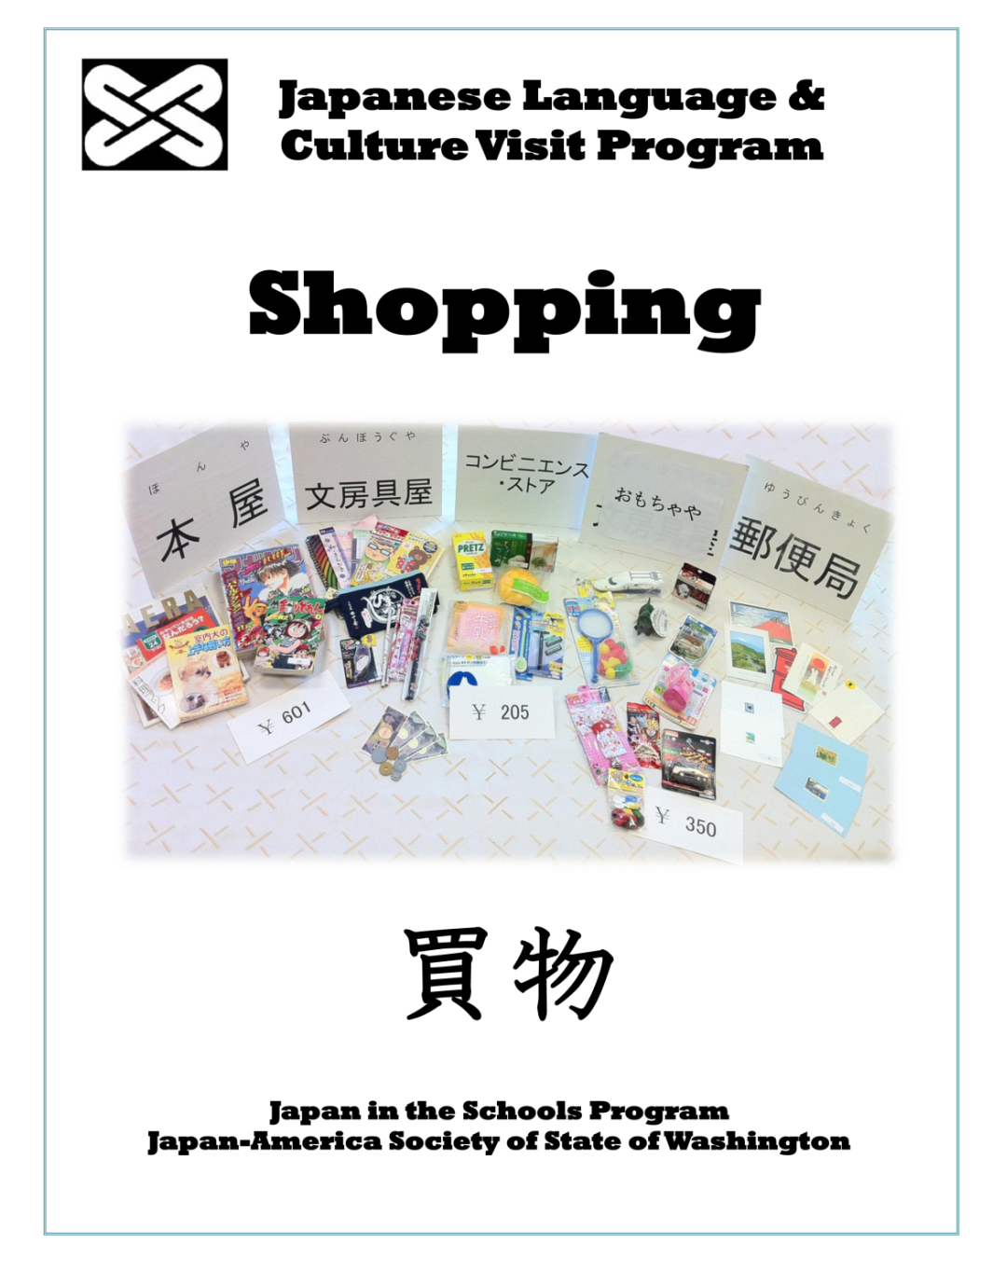
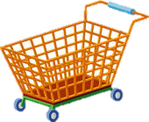
Generous support provided by:
©Japan-America Society of State of Washington
Notes:
This template can be used as a starter file for presenting training materials in a group setting.
Sections
Right-click on a slide to add sections. Sections can help to organize your slides or facilitate collaboration between multiple authors.
Notes
Use the Notes section for delivery notes or to provide additional details for the audience. View these notes in Presentation View during your presentation.
Keep in mind the font size (important for accessibility, visibility, videotaping, and online production)
Coordinated colors
Pay particular attention to the graphs, charts, and text boxes.
Consider that attendees will print in black and white or grayscale. Run a test print to make sure your colors work when printed in pure black and white and grayscale.
Graphics, tables, and graphs
Keep it simple: If possible, use consistent, non-distracting styles and colors.
Label all graphs and tables.

Slide 2
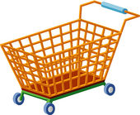
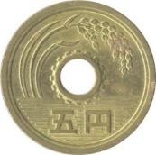
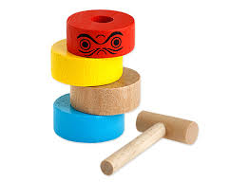
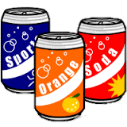
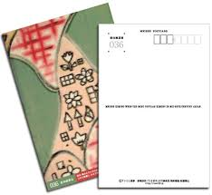
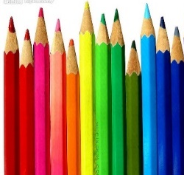
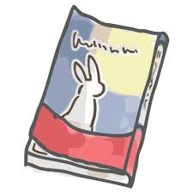
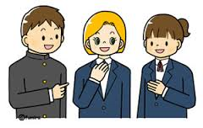
Today’s Shopping Visit
なに
か
日本で何を買いたいですか？
What do you want to buy in Japan?
お金の数え方の練習
Counting money
単語と表現の練習
Words and Phrases
数え方の練習
Counters
先生へのレポート
Post-Shopping Report
©Japan-America Society of State of Washington

Slide 3
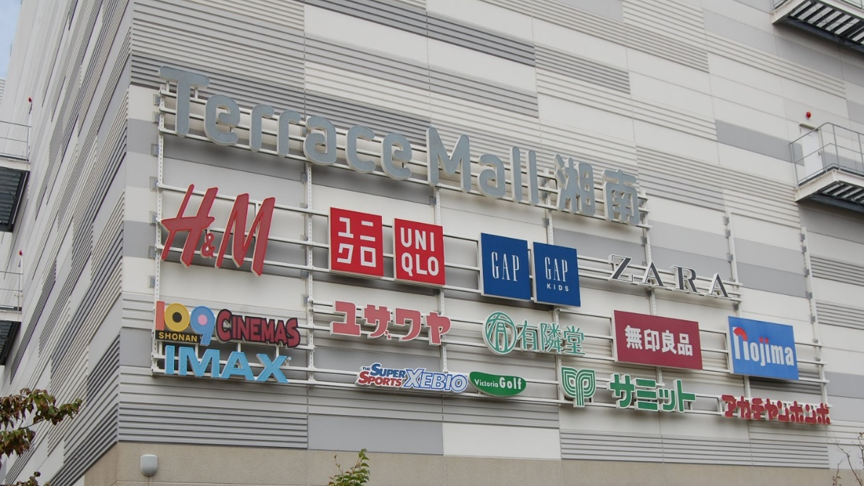
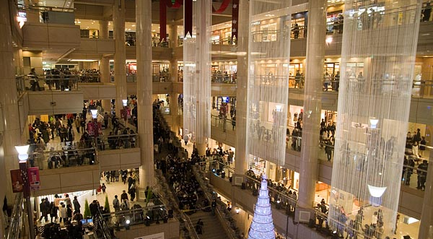
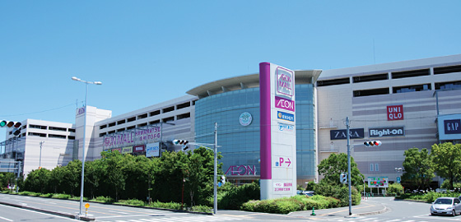
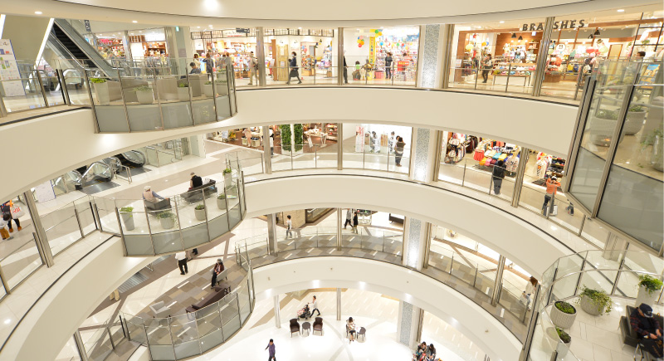
Malls
©Japan-America Society of State of Washington
Notes:
Malls in Japan
Malls are really big, these malls in the pictures on the left are 5 stories high. In kagoshima there is a mall 8 stories high! Malls are built up, instead of spread out like in the U.S. Our malls have several big department stores in them, but in Japan its usually just a lot of boutique clothing stores.
Usually there is a movie theater on the top level
Aeon is a big mall chain in Japan
Do you recognize any brands? Big US brands like H&M, Forever 21 can only be found in big cities, but Gap is found even in small towns

Slide 4
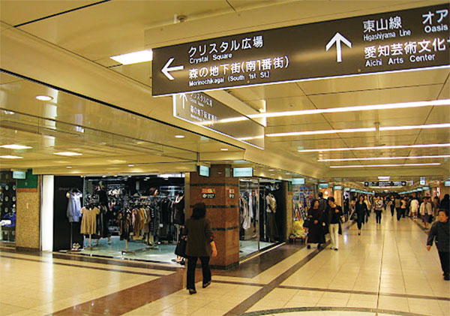
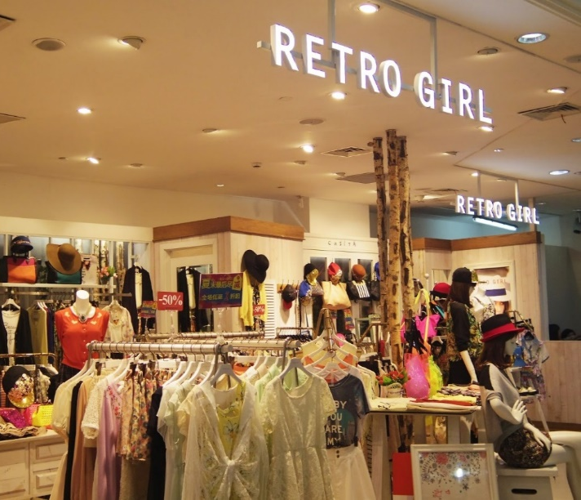
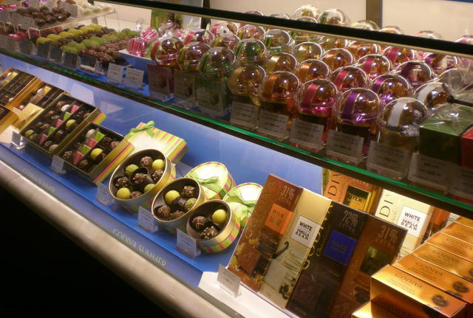
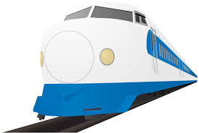
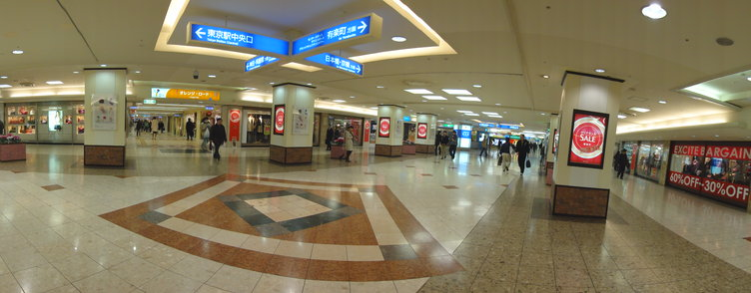
Underground Malls
These malls are under train stations
Overhead signs tell where the platforms are
©Japan-America Society of State of Washington
Notes:
Underground Mall
Big cities have malls that run underground.
They are connected to train stations. Here you can see the sign pointing the way to the train line
Umeda station in Osaka has a very famous underground mall

Slide 5
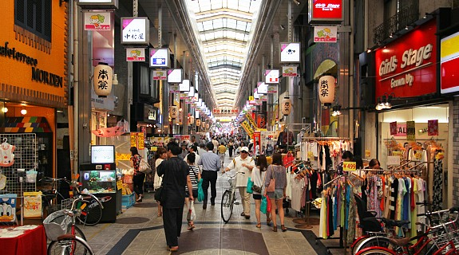
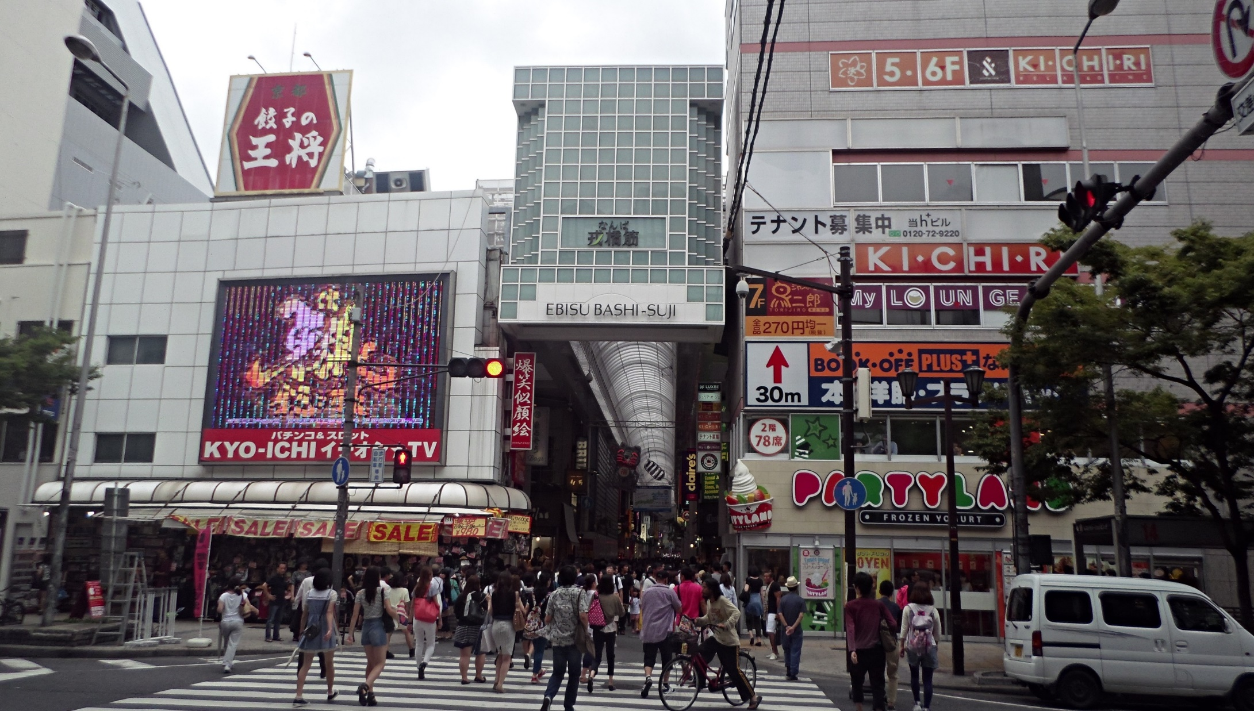
Shopping Arcades
©Japan-America Society of State of Washington
Notes:
Shopping Arcade
Malls in Japan are pretty expensive. If you want to buy things for cheap, whether clothes, shoes, etc its good to check out an open air shopping arcade
They are covered walkways/alleyways and inside are restaurants, stores, karaoke, fresh food, etc.

Slide 6
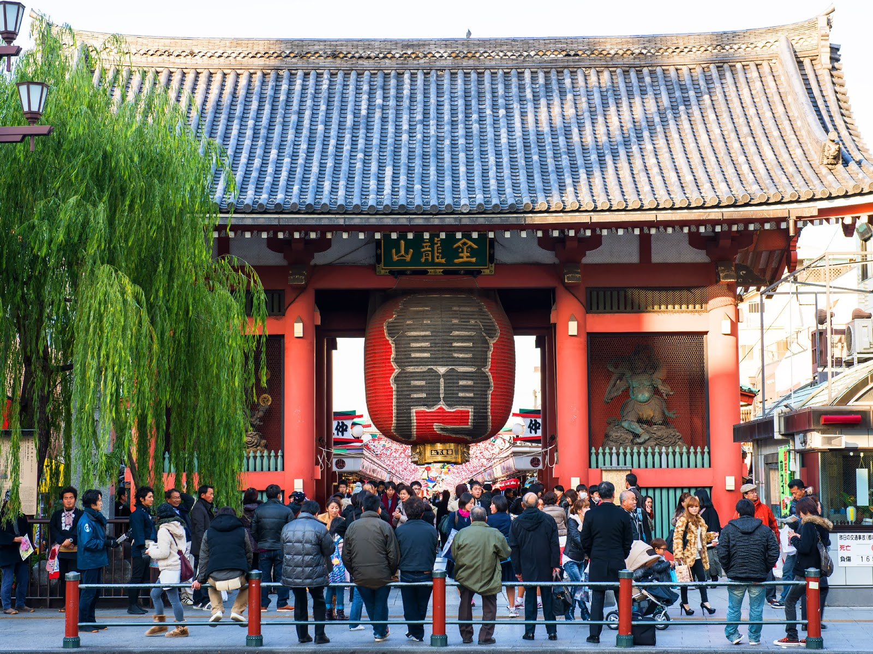
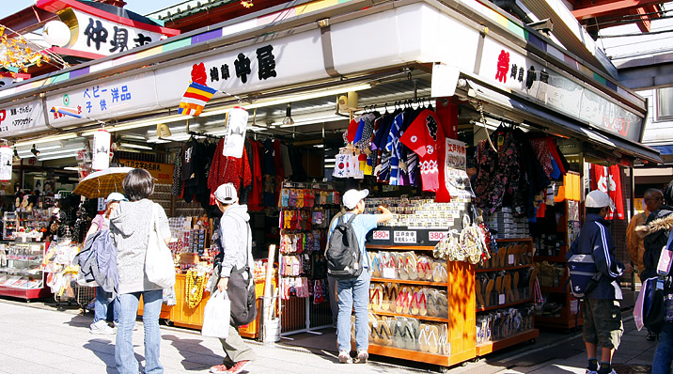
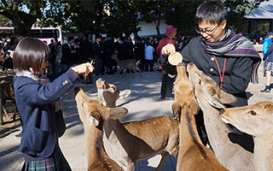
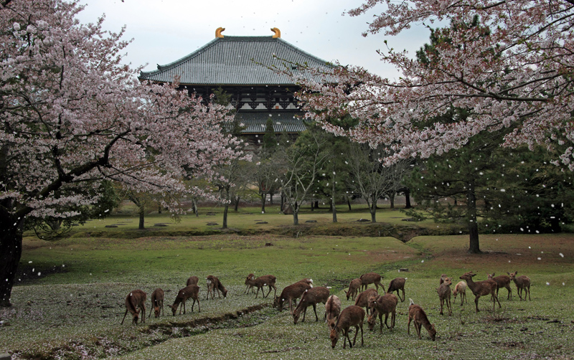
かんこう ～ おみやげ
©Japan-America Society of State of Washington

Slide 7
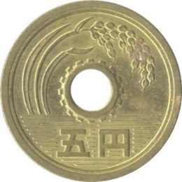
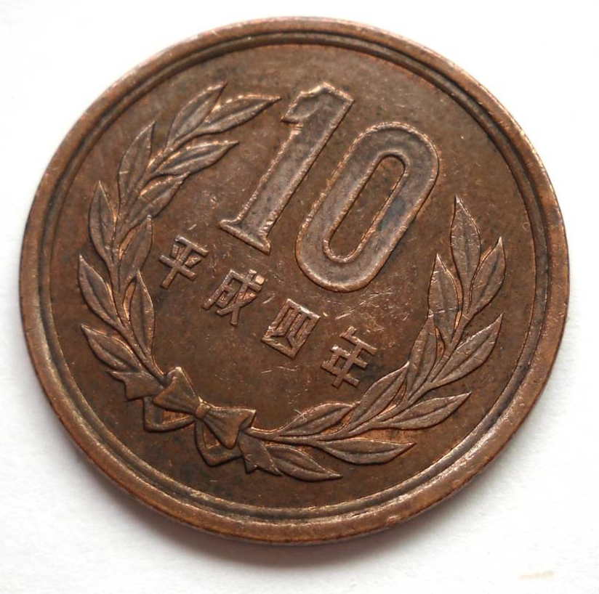
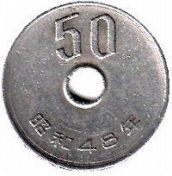
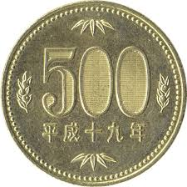
かぞ
数えられますか？
円
えん
©Japan-America Society of State of Washington
Notes:
Money
With US money, we start with 1 penny, and then have a different name for each amount counting up. 5 pennies is a nickel, 10 pennies is a dime, and then at 100 pennies we reset it to 1 dollar. Then we count 5 dollars (500 pennies) 10 dollars (1000 pennies)
In Japan, they don’t change the name. They just say 1 yen, 5 yen, 10 yen, 100 yen, 500 yen, 1000 yen.
So 100 yen is the same as 1 dollar. 500 yen the same as 5 dollars. 1000 yen the same as a 10 dollar bill

Slide 8
いくらですか？
1.
2.
3.
©Japan-America Society of State of Washington
Notes:
Counting Practice
How do we say this in Japanese?
When counting with bills, just say the largest bill first, then the rest. So “sen, go hyaku en”

Slide 9
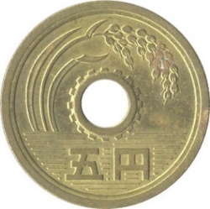
いくらですか？
4.
5.
6.
©Japan-America Society of State of Washington
Notes:
Counting Cont’d
1. Say the large bill first, then the next two. “Ichiman, Nisen en”

Slide 10
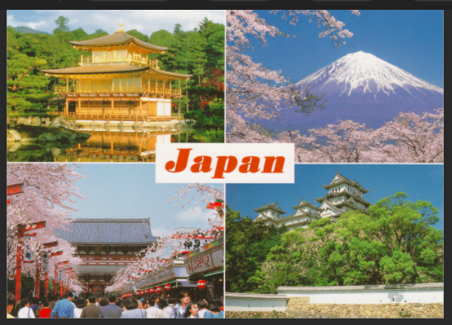
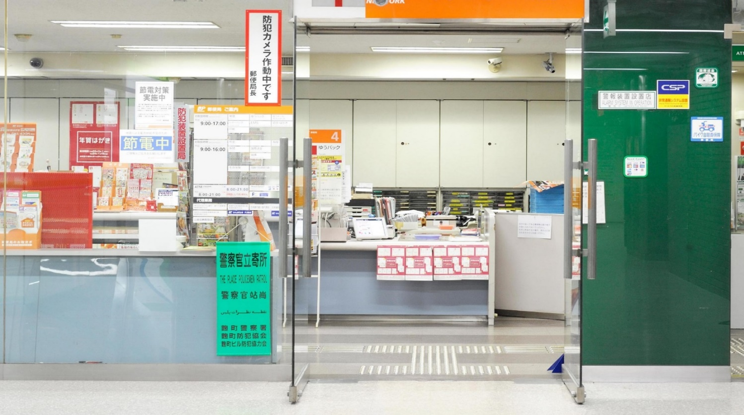
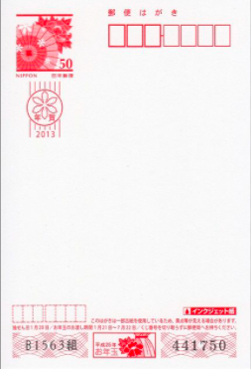
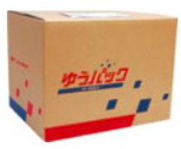
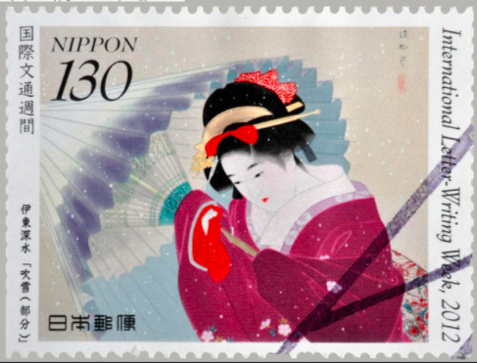
郵便局 ー ゆうびんきょく
＿＿ は いくら です か？
はがき
A: はがき は いくらですか？
B: 110円 です。
A: ３ まい ください。
B: はい、330円 です。
はがき
えはがき
きって
ふうとう
はこ
マーカー
えはがき
きって
ふうとう
はこ
マーカー
©Japan-America Society of State of Washington
Notes:
Have the Japanese speaker read the words, and they repeat.
Listen to how they pronounce it differently! Do you hear the Japanese accent? Try to say it just like them!
Do you know what these vocab words are?
Practice the conversation
Students are A-san, teacher is B-san

Slide 11
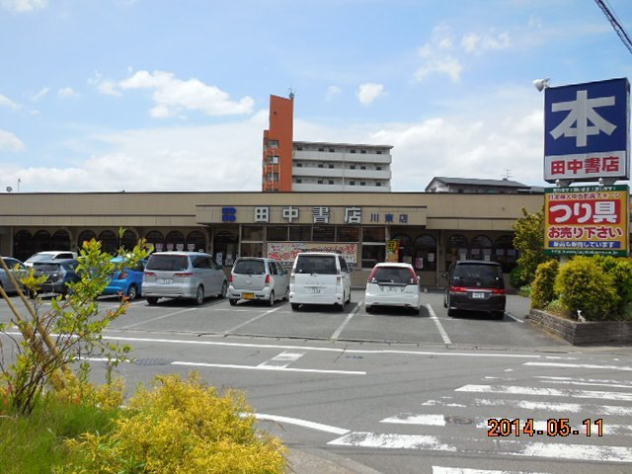
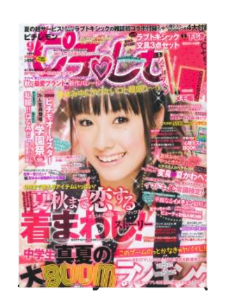
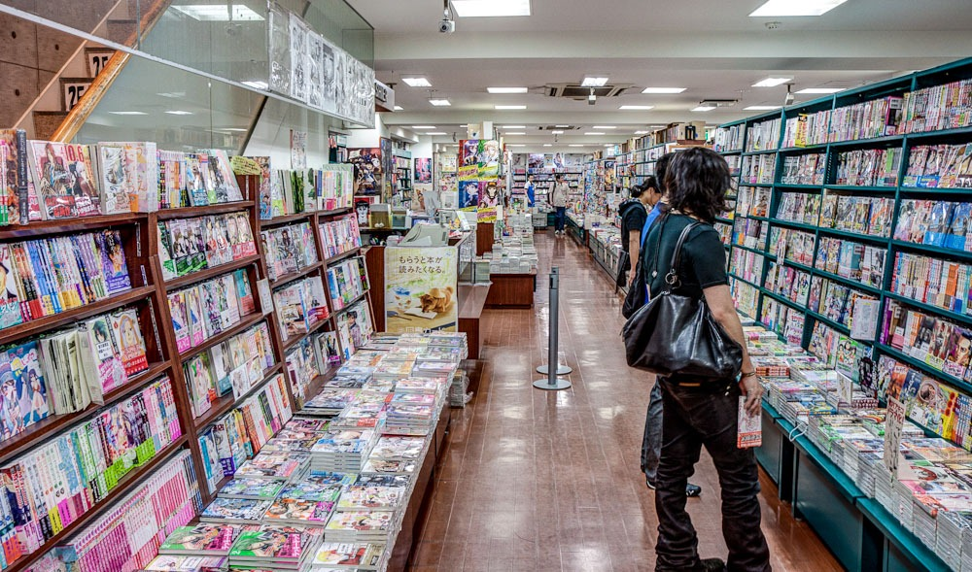
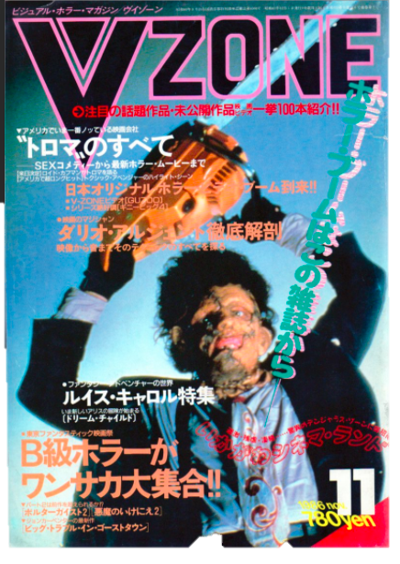
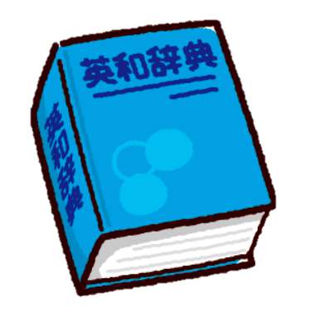
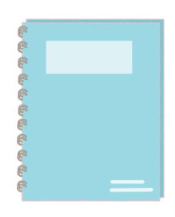
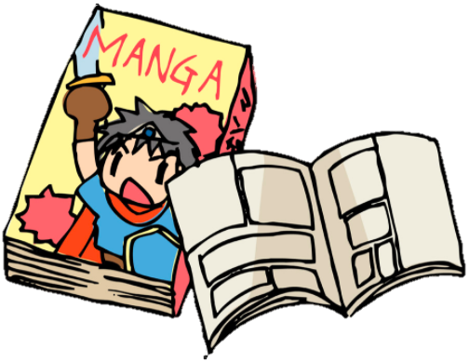
本屋 ー ほんや
さが
＿＿＿＿を探しています
ほん
A: まんが を さがしています。
B: どんな まんが ですか？
A: ナルト の まんが です。
B: はい、 こちらです。
ほん
ざっし
まんが
えんぴつ
じしょ
ノート
ざっし
まんが
えんぴつ
ノート
じしょ
ノート
©Japan-America Society of State of Washington
Notes:
Have the Japanese speaker read the words, and they repeat.
Listen to how they pronounce it differently! Do you hear the Japanese accent? Try to say it just like them!
Do you know what these vocab words are?
Practice the conversation
Students are A-san, teacher is B-san

Slide 12
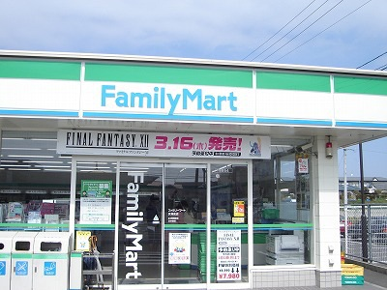
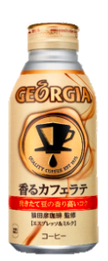
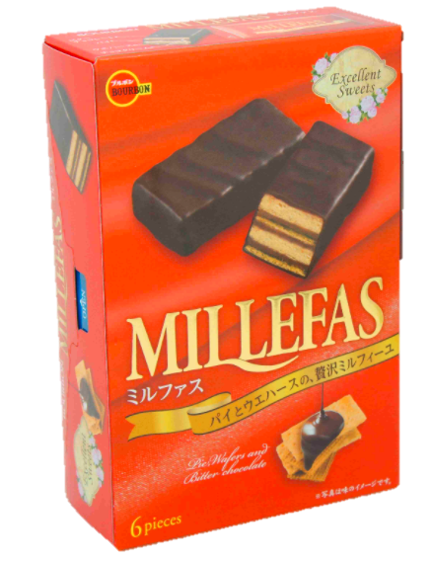
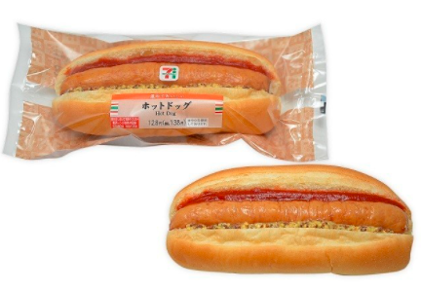
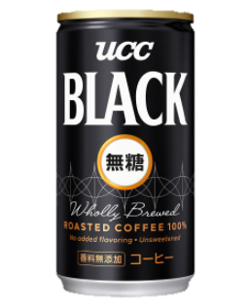
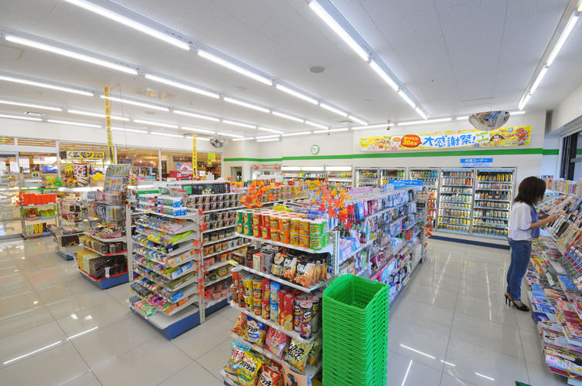
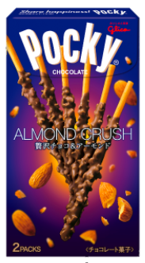
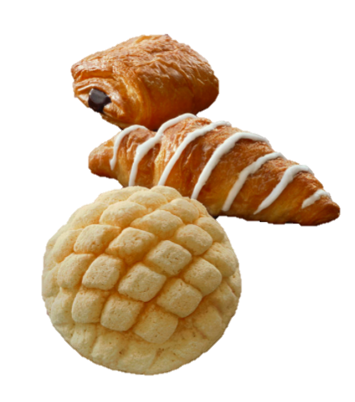
コンビニ
＿＿＿ は どこ です か？
コーヒー
A: コーヒー は どこですか？
B: こちら です。
A: コーヒーを ２ほん ください。
B: はい、240円です。
コーヒー
ジュース
おかし
パン
タオル
ホットドッグ
ジュース
おかし
パン
タオル
ホットドッグ
©Japan-America Society of State of Washington
Notes:
Have the Japanese speaker read the words, and they repeat.
Listen to how they pronounce it differently! Do you hear the Japanese accent? Try to say it just like them!
Do you know what these vocab words are?
Practice the conversation
Students are A-san, teacher is B-san

Slide 13
おもちゃ屋 － おもちゃや
か
_____ を 買いたい です。
ゲーム
A: すみません。シール を 買いたい です。
B: どんな シール ですか？
A: どうぶつ の シール を ください。
B: はい、 こちら です。
ゲーム
トレカ
フィギュア
けんだま
シール
にんぎょう
トレカ
フィギュア
けんだま
シール
にんぎょう
©Japan-America Society of State of Washington
Notes:
Have the Japanese speaker read the words, and they repeat.
Listen to how they pronounce it differently! Do you hear the Japanese accent? Try to say it just like them!
Do you know what these vocab words are?
Practice the conversation
Students are A-san, teacher is B-san

Slide 14
Debit & Credit
©Japan-America Society of State of Washington
©Japan-America Society of State of Washington
Notes:
Greeting and Misc. Rules
In Japan, store people greet you by saying “Irrashaimase!” They yell it loudly to call you into their store
Do you know what this cat is? He is the “maneki neko” or the beckoning cat. He’s beckoning customers and wealth into the store.
Japan is a cash based-society. Some places might not even take credit cards. People carry around large amounts of cash on them, and you can pay at the conbini or the dollar store with an ichiman en bill and it’s totally normal. Here we would assume it’s a fake!
When handing money over in Japan, you never put it directly in someone’s hand. There is a little money tray that you put the money into, and then the store person counts in and collects it.

Slide 15
レポート
How Was Your Shopping Trip?
生徒は、
なにをかいましたか？
どこでかいましたか？
どこで何を買いましたか？
おつりはいくらですか？
を、先生にレポートする。
Students tell teacher:
What did you buy?
Where did you buy it?
What & where?
How much change?
©Japan-America Society of State of Washington

Slide 16
フレーズの練習
Practice Phrases
＿＿ほん（ぼん・ぽん）
1. これ（それ）は なん ですか？
2. ＿＿＿は、いくら ですか？
3. これ（それ）を (counter) ください。
4. ＿＿＿を さがして います。
5. ＿＿＿は、どこ ですか？
6. ＿＿＿を かいたい です。
7. ＿＿＿を ください。
8. ＿＿＿を＿＿＿ください。
9. もうすこしやすいのがありますか？
＿＿さつ
＿＿まい
＿＿こ
かね
お金を
トレーに
おいてください
©Japan-America Society of State of Washington
Notes:
1万円を千円札10枚に両替する change a 10,000-yen bill into ten 1,000-yen bills
Can't you make it a little cheaper?もう少し安くしてもらえませんか。 Make it 20 dollars.20 ドルにしてください

